Slide 1
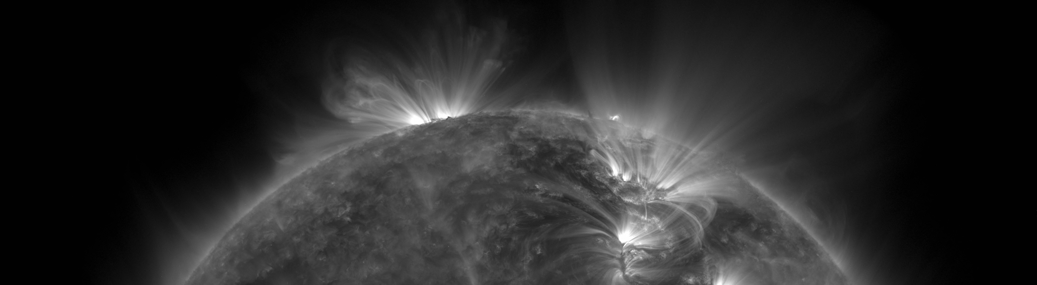
EUV Solar Telescope Using Fresnel Zone Plates
Roy Smart
EELE582 Optical Design
Montana State University

Slide 2
Motivation
The solar atmosphere is often investigated by using extreme ultraviolet (10nm-124nm) telescopes.
Building optical systems in this regime is difficult since EUV photons are absorbed by all known elements.
Requires using space-based observatories
Current EUV imaging systems use multilayer reflective optics to focus light.
EUV multilayer optics are difficult to design and extremely expensive to produce.
Can we do better?

Slide 3
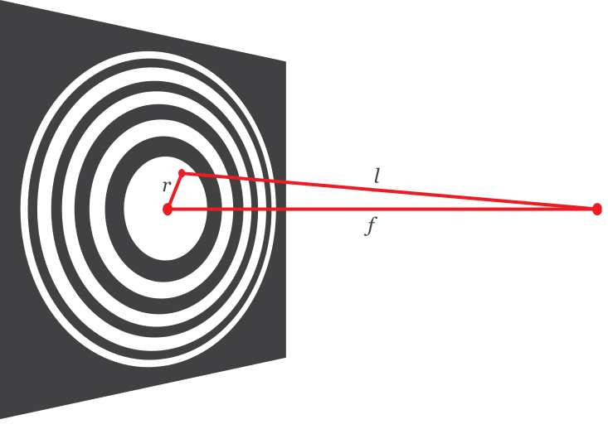
Introducing the Fresnel Zone Plate
Diffractive imaging system.
Plate is divided into zones, alternating between opaque and transparent.
Zones are placed such that incoming plane waves constructively interfere at the focus.
Good candidate for EUV imaging.

Slide 4
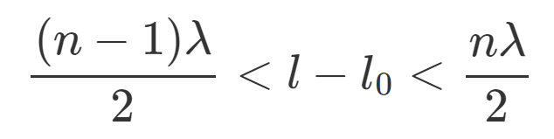
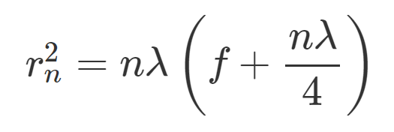
Fresnel Zone Plate Theory
The condition for constructive interference at the focus is
The radii where the zone plate switches from opaque to transparent is then

Slide 5
Fresnel Zone Plate Challenges
The location of the zones is wavelength dependent, leading to severe chromatic aberration.
Resolution of the zone plate is limited by the width of the smallest zone (diffraction limit).
Zone plates are often manufactured using lithography, which currently achieve 10nm spot-sizes.

Slide 6
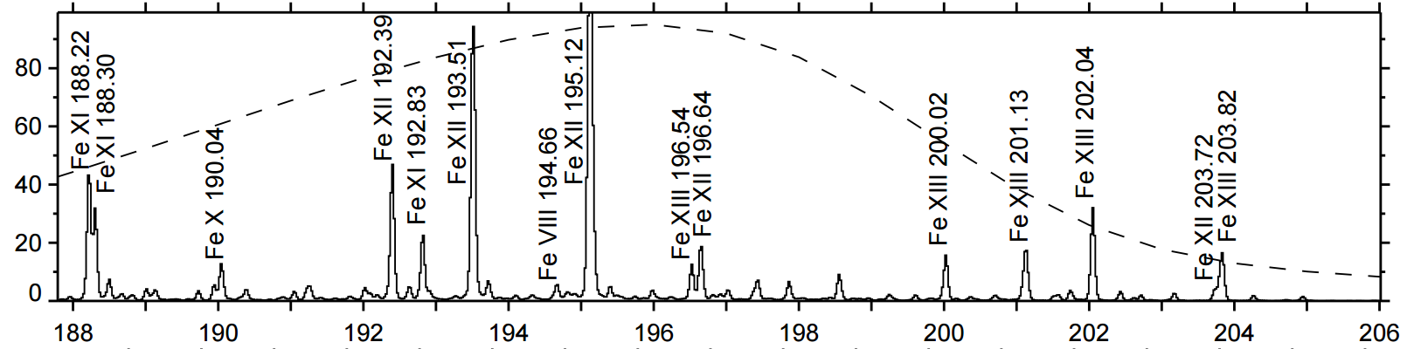
Solar EUV Telescope Requirements
Narrow passband
19.3nm to 19.5nm capturing two Fe XII emission lines
Narrow-band filter will not be modeled in Zemax, we will simply model the propagation of these two wavelengths.

Slide 7
Solar EUV Telescope Requirements
Narrow passband
19.3nm to 19.5nm capturing two Fe XII emission lines
Narrow-band filter will not be modeled in Zemax, we will simply model the propagation of these two wavelengths.

Slide 8
Solar EUV Telescope Requirements
Current observatories such as the Solar Dynamics Observatory (SDO) achieve sub-arcsecond (0.6”) resolution.
We would like to match this performance.
Full-disk imaging of the sun requires a 1900”x1900” (0.53x0.53 deg.) field of view.

